Slide 1

LENDING CLUB case study
Puneet Grover
Chandirakumar Muthu

Slide 2
The Problem
Company
Lending club is the largest online loan marketplace, facilitating personal loans, business loans, and financing of medical procedures. Borrowers can easily access lower interest rate loans through a fast online interface.
Context
Understand the driving factors (or driver variables) behind loan default, i.e. the variables which are strong indicators of default. The company can utilise this knowledge for its portfolio and risk assessment.
Problem statement
Analyze the dataset using EDA to understand how consumer attributes and loan attributes influence the chances of default

Slide 3
Data cleaning
Univariate analysis
Bivariate analysis
Recommendations
Approach

Slide 4
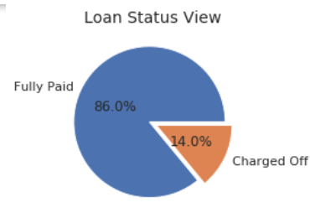
Overall loan bird-eye view
Approximately 14% of the loans are defaulted.

Slide 5
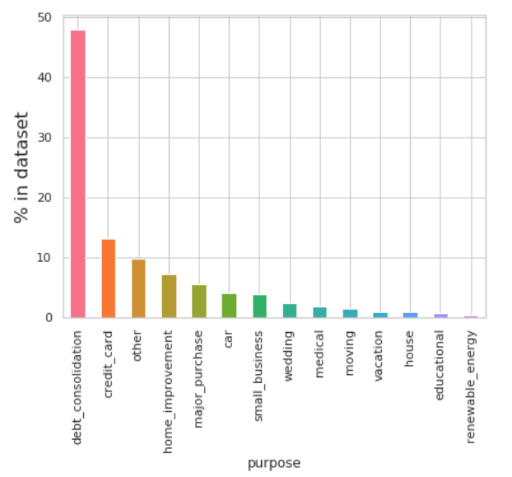
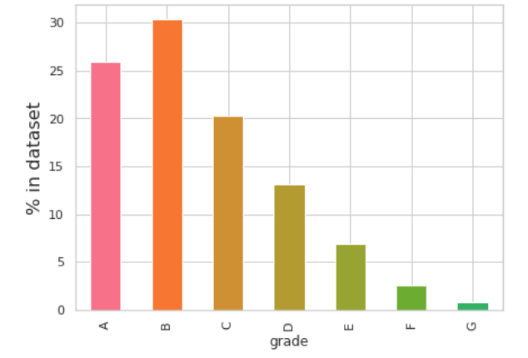
Loan analysis
Maximum no of loans are of debt consolidation
Maximum no of loans are of grade A & B

Slide 6
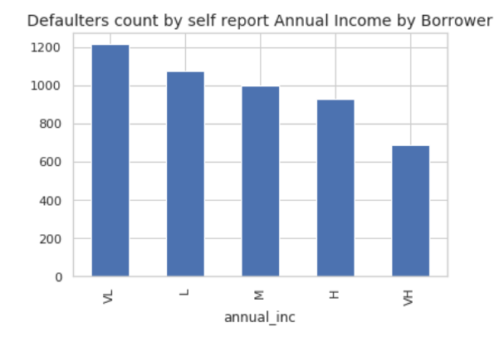
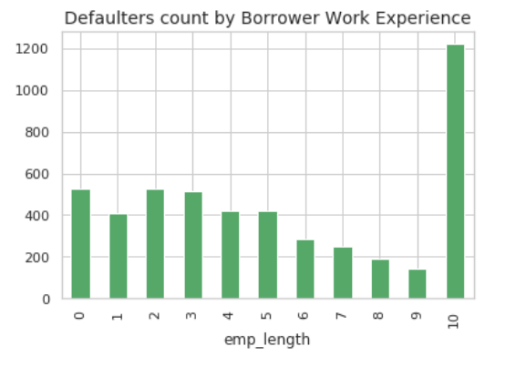
Loan analysis
Lower the income, higher is the chance of default
More experienced the person, higher is the chance of default

Slide 7
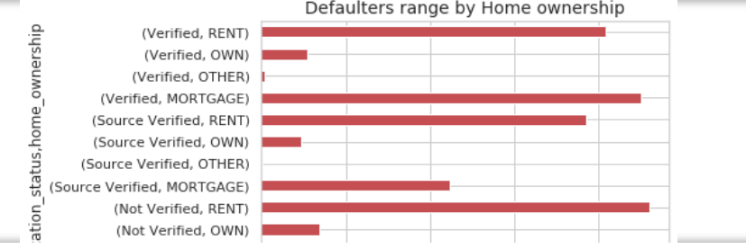
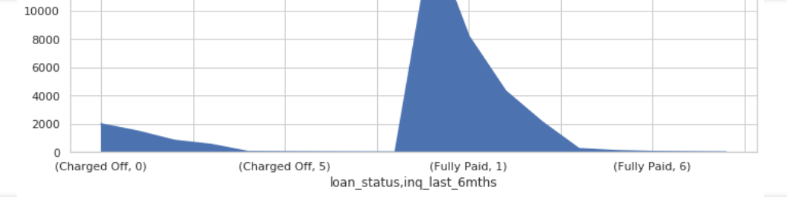
Loan analysis
Borrower who are in rented ownership and mortgage are having more % of to be defaulter
Could not make any inference on the number of enquiries

Slide 8
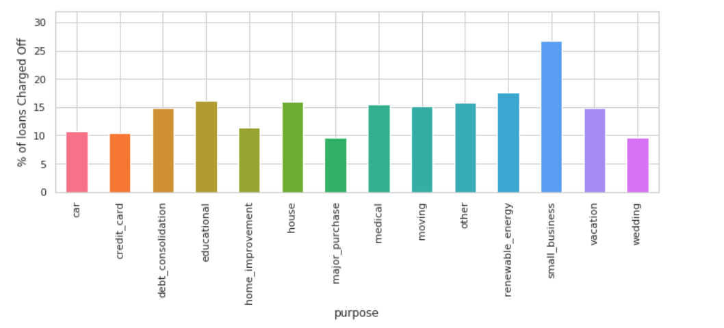
Default by loan purpose
Loans taken for the purpose of small business sees the highest default. We should avoid it.

Slide 9
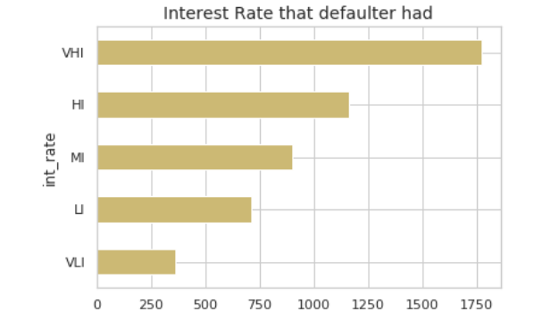
Loan analysis
Very high interest rate had the highest count of defaults. With increasing interest rates, the chances of default increase.

Slide 10
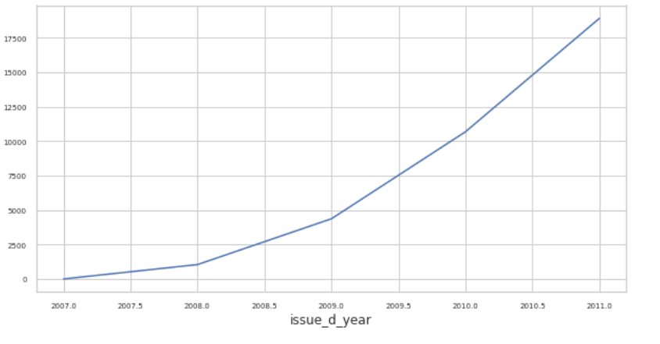
Loan analysis
Loan amount over a period of time.

Slide 11
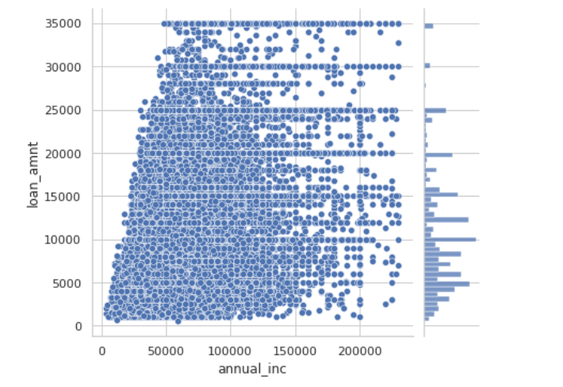
Loan analysis
This depicts the loan amount vs annual income, average income lower than 50000 taking loans of 25000 or higher. These would be risky loans.

Slide 12
Recommendations
5 Driving factors for defaulters of the loan: interest rate, annual income, emp experience, purpose, dti
Reduce the percentage of loans where reason is debt consolidation/ Increase the rate of interest of such cases; Attractive interest rates can be offered to the category of ‘renewable energy’
Avoid giving loans to the number of people with very low-income group, On the flipside, the loans can be given out to the people with Very high income at more attractive rates as they have low chances of default
Avoid giving loans to people with high experience
Avoid giving loans for the small businesses
Interest rates could be increased for the cases where dti greater than 20

Slide 13
Thank you!

